Slide 1

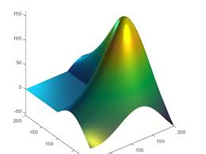
ENGR 4399 Introduction to Machine Learning for Engineers
Lecture #8: k-means Clustering
September 17, 2020

Slide 2
In-Class #8a: k-means
load data from “kmeansInClassData.txt” to a table array
Perform a k-means cluster analysis
Create a 2D scatter plot

Slide 3
Solution
X = readtable('kmeansInClassData.txt')
X = table2array(X)
grp = kmeans(X,4)
[X,grp]
scatter(X(:,1),X(:,2),30,grp,'filled')

Slide 4
k-means
Most well-known and popular clustering algorithm:
Start with some initial cluster centers
Iterate:
Assign/cluster each example to closest center
Recalculate centers as the mean of the points in a cluster

Slide 5
k-means: an example

Slide 6
k-means: Initialize centers randomly

Slide 7
k-means: assign points to nearest center

Slide 8
k-means: readjust centers

Slide 9
k-means: assign points to nearest center

Slide 10
k-means: readjust centers

Slide 11
k-means: assign points to nearest center

Slide 12
k-means: readjust centers

Slide 13
k-means: assign points to nearest center
No changes: Done

Slide 14
k-means
Iterate:
Assign points to the closest center
Recalculate centers as the mean of the points in a cluster

Slide 15
k-means
Iterate:
Assign/cluster each example to closest center
Recalculate centers as the mean of the points in a cluster
iterate over each point:
- get distance to each cluster center
- assign to closest center
What distance measure should we use?

Slide 16
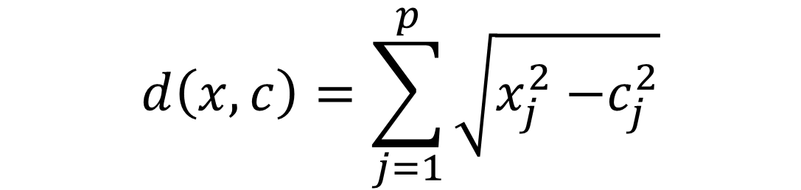
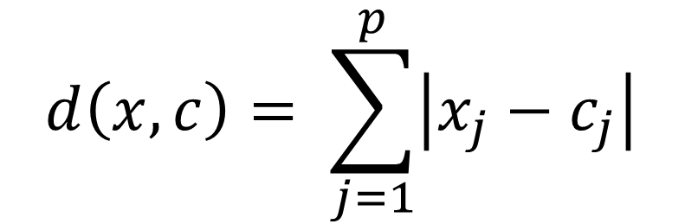
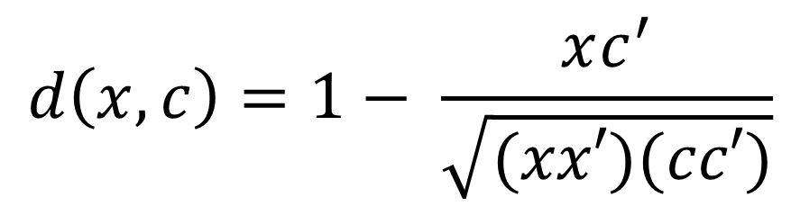
How we measure distance
Euclidean (default in MATLAB):
$$d\left(x,c\right)=\sum_{j=1}^{p}{\sqrt{x_{j}^{2}{−c}_{j}^{2}}}$$
City Block:
$$d\left(x,c\right)= \sum_{j=1}^{p}{\left|x_{j}−c_{j}\right|}$$
Cosine:
$$d\left(x,c\right)=1− \frac{xc^{′}}{\sqrt{(xx′)(cc′)}}$$

Slide 17
k-means
Iterate:
Assign points to the closest center
Recalculate centers as the mean of the points in a cluster
Where are the cluster centers?

Slide 18
k-means
Iterate:
Assign/cluster each example to closest center
Recalculate centers as the mean of the points in a cluster
How do we calculate these?

Slide 19
k-means
Iterate:
Assign/cluster each example to closest center
Recalculate centers as the mean of the points in a cluster
Mean of the points in the cluster:

Slide 20
What is k-means doing?
k-means tries to minimize what is called the “k-means” loss function:
that is, the sum of the squared distances from each point to the associated cluster center
Does each step of k-means move towards reducing this loss function (or at least not increasing)?

Slide 21
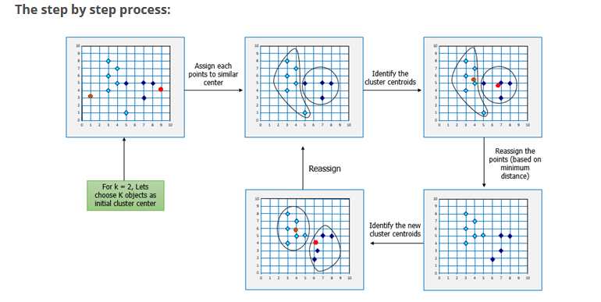
k-means process flow

Slide 22
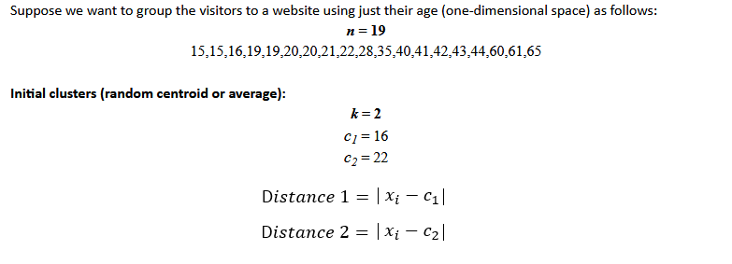
k-means 1D example

Slide 23

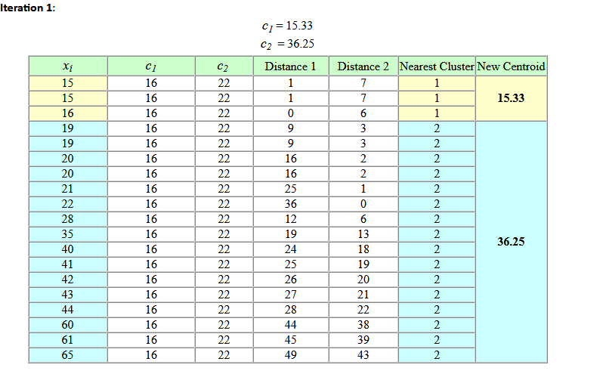
k-means 1D example

Slide 24
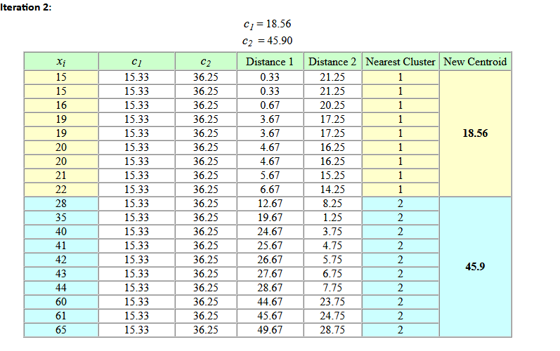
k-means 1D example

Slide 25
In-Class #8b: k-means
load the basket ball stats data file called “bball.txt”
2) Save all the numerical categories from “bball.txt” into a variable called “stats”
3) Normalize the values in your “stats” variable by using the MATLAB function zscore and save it in a new variable called “statsNorm”
4) Perform a kmeans clustering analysis with 2 clusters using a distance that provides the “smallest total sum of distances” using “statsNorm”

Slide 26
%% Import & intialize data
data = readtable('bball.txt');
stats = data{:,[ 5 6 11:end ]};
labels = data.Properties.VariableNames([ 5 6 11:end ]);
statsNorm = zscore(stats);
%% TODO: Group data using k-means clustering
grp = kmeans(statsNorm,2,'Distance','cityblock','Replicates',5,'Display','final');
grp = kmeans(statsNorm,2,'Distance','sqeuclidean','Replicates',5,'Display','final');
grp = kmeans(statsNorm,2,'Distance','cosine','Replicates',5,'Display','final');
%% View data
scatter3(scrs(:,1),scrs(:,2),scrs(:,3),10,grp)

